Slide 1
C
PROGRAMMING FOR PROBLEM SOLVING
Course Code: 24EN1202
Course Instructor:
Academic Year: 2025-2026
Year :1st
Semester : I

Slide 2
C PROGRAMMING LANGUAGE
C language Tutorial with programming approach for beginners and professionals, helps you to understand the C language tutorial easily.
The C Language is developed by Dennis Ritchie for creating system applications that directly interact with the hardware devices such as drivers, kernels, etc.
C programming is considered as the base for other programming languages, that is why it is known as mother language.

Slide 3
IT CAN BE DEFINED BY THE FOLLOWING WAYS
Mother language.
System programming language.
Procedure-oriented programming language.
Structured programming language.
Mid-level programming language.

Slide 4
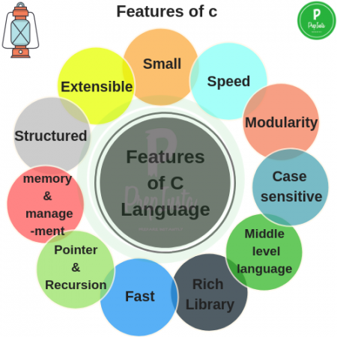
FEATURES OF C LANGUAGE
Simple
Machine Independent or Portable
Mid-level programming language
structured programming language
Rich Library
Memory Management
Fast Speed
Pointers
Recursion
Extensible

Slide 5
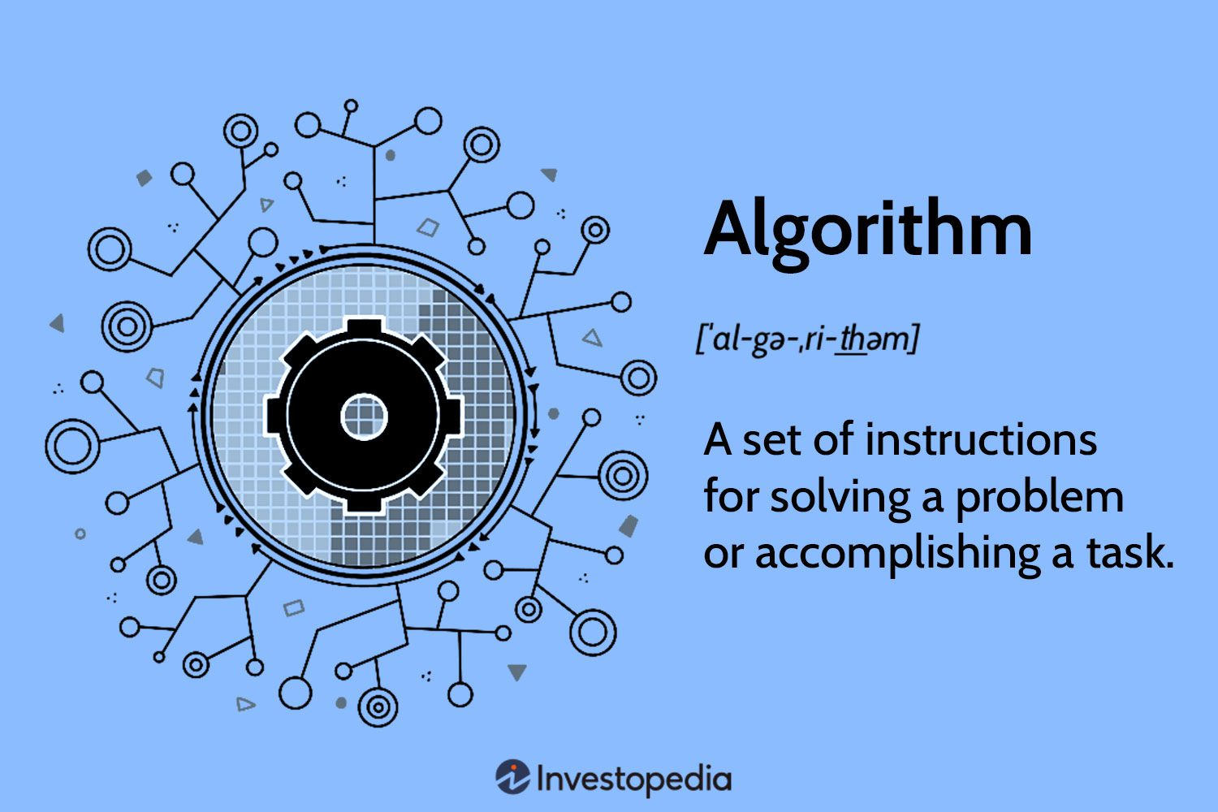
Algorithm
An algorithm presents step by step instructions required to solve any problem.

Slide 6
Q: - Write the algorithm to find the sum and product of given two numbers.
Solution:
Algorithm:
Start
Read a, b
Sum a + b
Product a x b
Print Sum, Product
Stop

Slide 7
Flowchart
Flowchart is a symbolic or diagrammatic representation of an algorithm. It uses several geometrical figures to represent the operations, and arrows to show the direction of flow.

Slide 8
Flowchart
Start/Stop
looping
Input/ Output
Connector
Processing
Checking/Decision making
Arrows
Comments / Explanation

Slide 9
Additional Symbols Related to more advanced Programming
Preparation (may be used with “do Loops” )
Refers to separate flowchart
Connector

Slide 10
Flowchart:
Start
Read a, b
Sum a+b
Product axb
Print sum, product
Stop

Slide 11
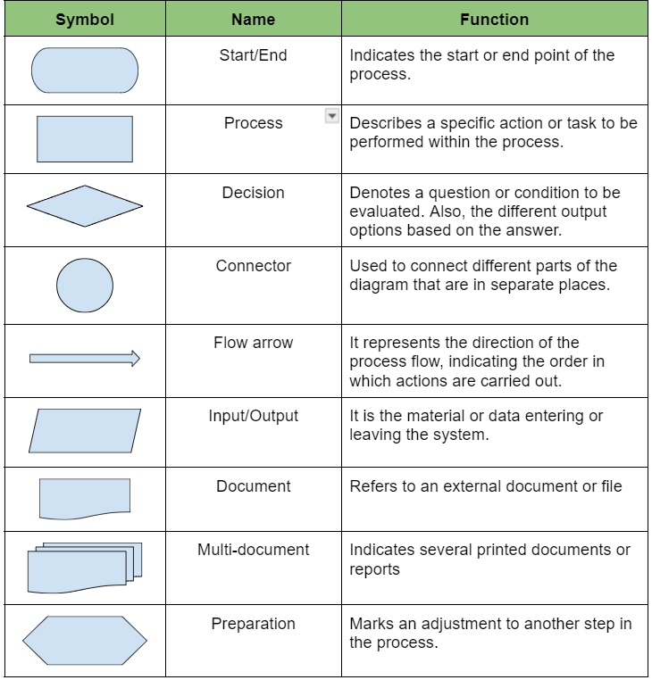

Slide 12
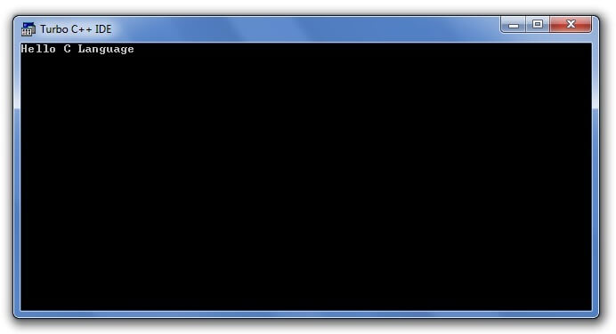
FIRST C PROGRAM
#include <stdio.h>
int main()
{
printf("Hello C Language");
return 0;
}
__________________________________________________________________
#include <stdio.h> includes the standard input output library functions.
The printf() function is defined in stdio.h .
int main() The main() function is the entry point of every program in c language.
printf() The printf() function is used to print data on the console.
return 0 The return 0 statement, returns execution status to the OS. The 0 value is used for successful execution and 1 for unsuccessful execution.

Slide 13
COMPILATION PROCESS IN C
What is a compilation?
The compilation is a process of converting the source code into object code.
It is done with the help of the compiler.
ex:- GNU Compiler Collection (GCC)
If the source code is error-free, then it generates the object code.

Slide 14
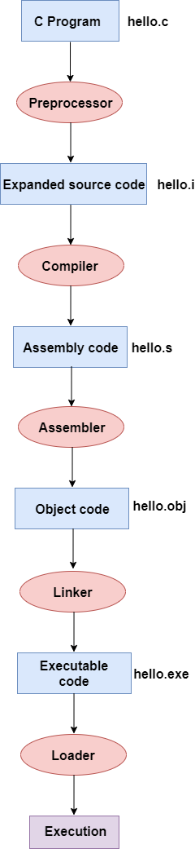
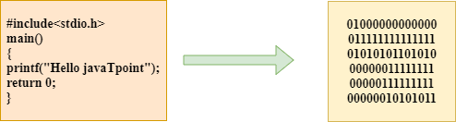
Preprocessor
Compiler
Assembler
Linker
Loader

Slide 15
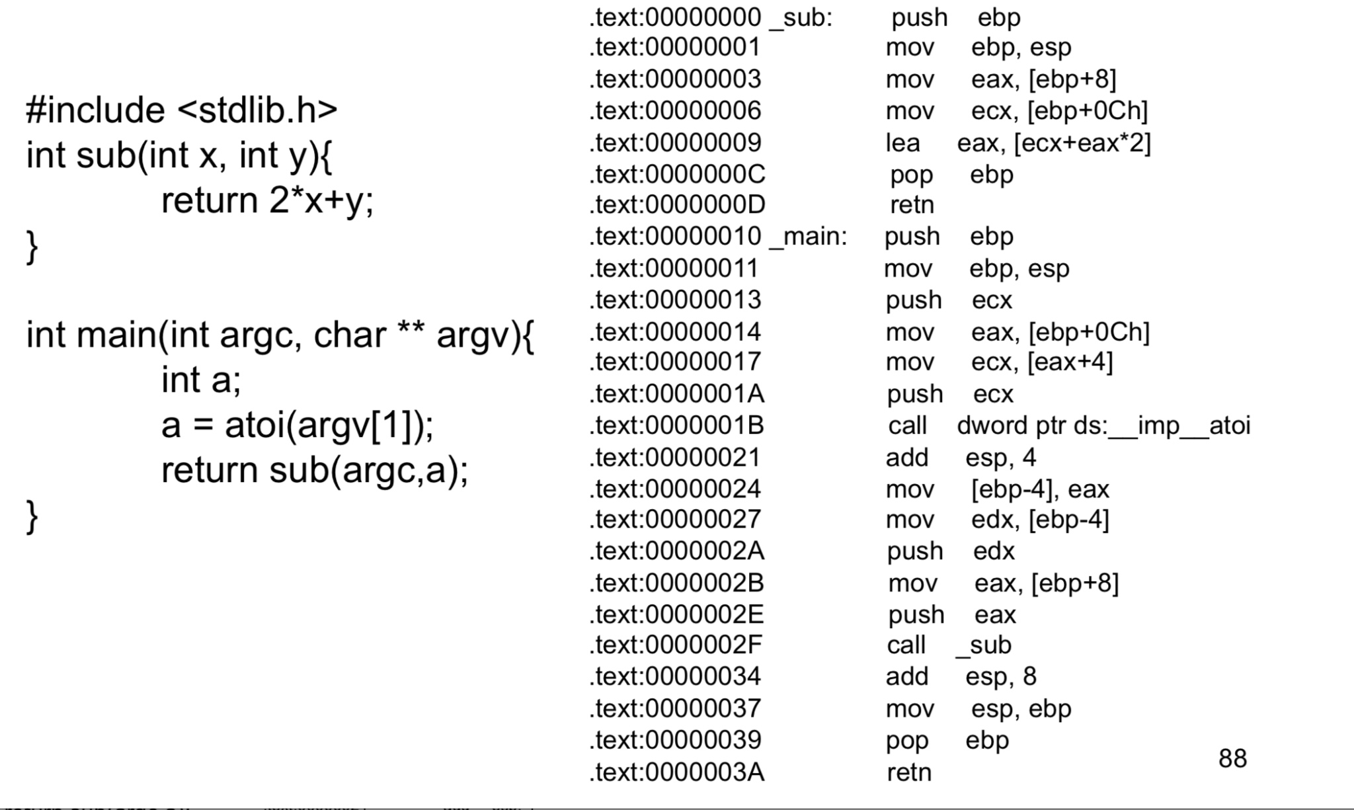

Slide 16
Keywords or Reserved Words
C language uses the following keywords which are not available to users to use them as variables/function names. Generally, all keywords are in lower case although uppercase of same names can be used as identifiers.
auto | break | case | enum
volatile | while | char | extern
switch | typedef | const | struct
short | union | continue | return
signed | unsigned | register | goto
sizeof | void | for | if
static | float | double | int
default | do | else | long

Slide 17
printf() & scanf() in C
printf() function
The printf() function is used for output. It prints the given statement to the console.
The syntax of printf() function is given below:
printf("format string", argument_list);
The format string can be %d (integer), %c (character), %s (string), %f (float) etc

Slide 18
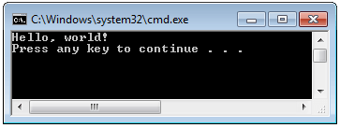
scanf() in C
scanf() function
The scanf() function is used for input.
It reads the input data from the console.
The syntax of scanf() function is given below:
scanf("format string",argument_list);
The format string can be &d (integer), &c (character), &s (string), &f (float) etc

Slide 19
Program to print cube of given number
#include<stdio.h>
int main()
{
int number;
printf("enter a number:");
scanf("%d",&number);
printf("cube of number is:%d ",number*number*number);
return 0;
}
___________________________________________________________
Output
Enter a number: 5
cube of number is: 125

Slide 20
Program to print sum of 2 numbers
#include<stdio.h>
int main()
{
int x=0,y=0,result=0;
printf("enter first number:");
scanf("%d",&x);
printf("enter second number:");
scanf("%d",&y);
result=x+y;
printf("sum of 2 numbers:%d ",result);
return 0;
}
Output
enter first number:9
enter second number:9
sum of 2 numbers:18

Slide 21
Variables in C
A variable is a name of the memory location. It is used to store data. Its value can be changed, and it can be reused many times.
Syntax to declare a variable:-
type variable_list;
ex :-
  int a;
  float b;
  char c;
Declaring 2 variable of integer type:-
type variable_list1, variable_list2;
Ex :-
int a=10,b=20;

Slide 22
RULES FOR DEFINING VARIABLES
A variable can have alphabets, digits, and underscore.
A variable name can start with the alphabet, and underscore only. It can't start with a digit.
No whitespace is allowed within the variable name.
A variable name must not be any reserved word or keyword, e.g. int, float, etc

Slide 23
Types of Variables in C
There are many types of variables in c:
local variable
global variable
static variable
automatic variable
external variable

Slide 24
Local Variable
A variable that is declared inside the function or block is called a local variable.
It must be declared at the start of the block.
________________________________
void function1()
{
int x=10; //local variable
}

Slide 25
Global Variable
A variable that is declared outside the function or block is called a global variable.
Any function can change the value of the global variable. It is available to all the functions.
____________________________________________________
int value=20; //global variable
void function1()
{
int x=10; //local variable
}

Slide 26
Static Variable
A variable that is declared with the static keyword is called static variable
If you call this function many times, the local variable will print the same value for each function call, e.g, 11,11,11 and so on.
But the static variable will print the incremented value in each function call, e.g. 11, 12, 13 and so on
void function1()
{
int x=10;//local variable
static int y=10;//static variable
x=x+1;
y=y+1;
printf("%d,%d",x,y);
}
__________________________________________________________

Slide 27
Automatic Variable
All variables in C that are declared inside the block, are automatic variables by default.
We can explicitly declare an automatic variable using auto keyword.
_____________________________________________________________
void main()
{
int x=10; //local variable (also automatic)
auto int y=20; //automatic variable
}

Slide 28
External Variable
We can share a variable in multiple C source files by using an external variable.
To declare an external variable, you need to use extern keyword
myfile.h
extern int x=10;//external variable (also global)
#include "myfile.h"
#include <stdio.h>
void printValue()
{
printf("Global variable: %d", global_variable);
}

Slide 29
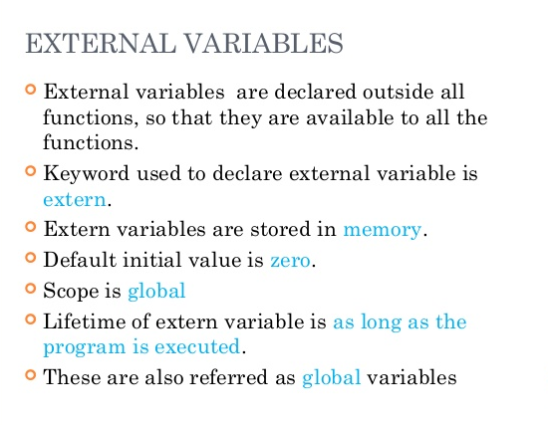

Slide 30
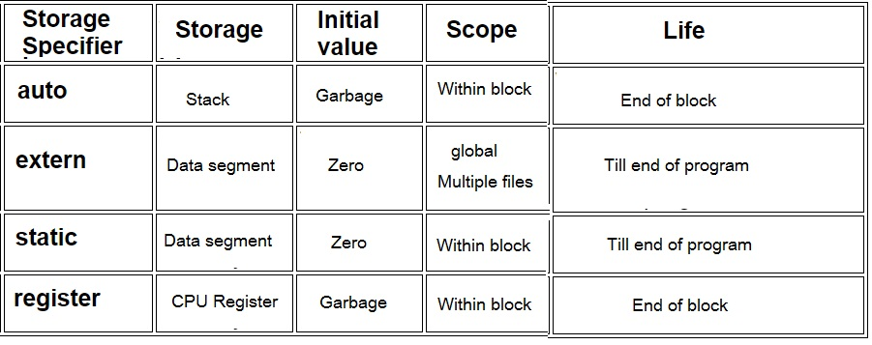

Slide 31
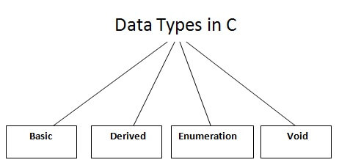
Data Types in C
C language data types are defined as the data storage format that a variable can store a data to perform a specific operation.
Data types are used to define a variable before to use in a program.
Size of variable, constant and array are determined by data types.
Types | Data Types
Basic Data Type | int, char, float, double
Derived Data Type | array, pointer, structure, union
Enumeration Data Type | enum
Void Data Type | void

Slide 32
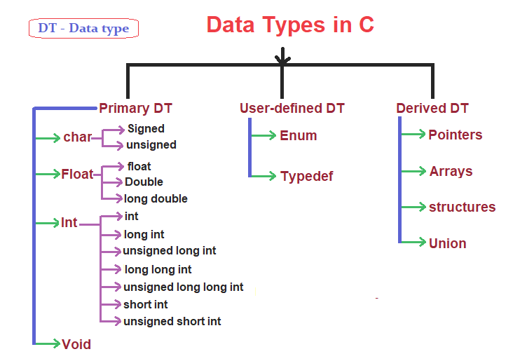

Slide 33
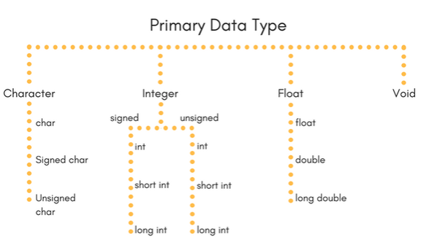

Slide 34
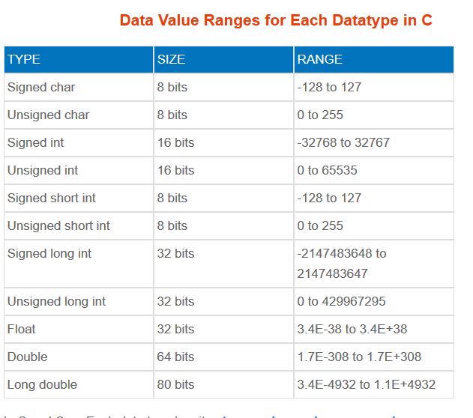

Slide 35
The memory size of the basic data types may change according to 32 or 64-bit operating system.
Let's see the basic data types.
Its size is given according to 32-bit architecture.
Data Types | Memory Size | Range
char | 1 byte | −128 to 127
signed char | 1 byte | −128 to 127
unsigned char | 1 byte | 0 to 255
short | 2 byte | −32,768 to 32,767
signed short | 2 byte | −32,768 to 32,767
unsigned short | 2 byte | 0 to 65,535
int | 2 byte | −32,768 to 32,767
signed int | 2 byte | −32,768 to 32,767
unsigned int | 2 byte | 0 to 65,535
short int | 2 byte | −32,768 to 32,767
signed short int | 2 byte | −32,768 to 32,767
unsigned short int | 2 byte | 0 to 65,535
long int | 4 byte | -2,147,483,648 to 2,147,483,647
signed long int | 4 byte | -2,147,483,648 to 2,147,483,647
unsigned long int | 4 byte | 0 to 4,294,967,295
float | 4 byte
double | 8 byte
long double | 10 byte

Slide 36
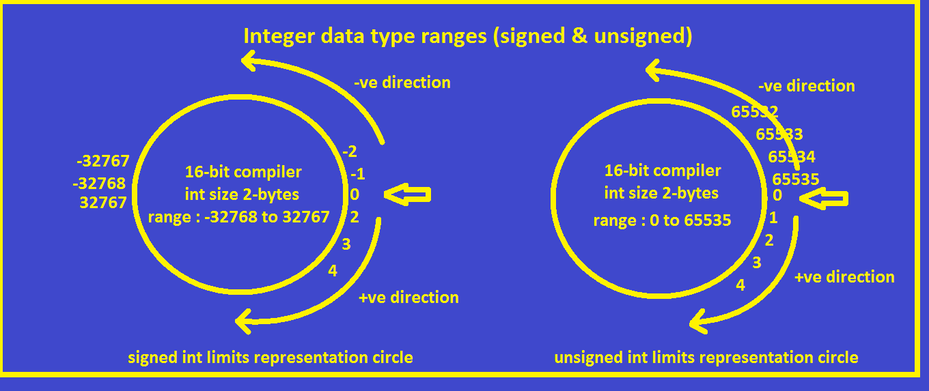

Slide 37
Keywords in C
A keyword is a reserved word. You cannot use it as a variable name, constant name, etc. There are only 32 reserved words (keywords) in the C language.
A list of 32 keywords in the c language
auto | break | case | char | const | continue | default | do
double | else | enum | extern | float | for | goto | if
int | long | register | return | short | signed | sizeof | static
struct | switch | typedef | union | unsigned | void | volatile | while

Slide 38
Rules for constructing C identifiers
The first character of an identifier should be either an alphabet or an underscore, and then it can be followed by any of the character, digit, or underscore.
It should not begin with any numerical digit.
In identifiers(Variables), both uppercase and lowercase letters are distinct. Therefore, we can say that identifiers are case sensitive.
Commas or blank spaces cannot be specified within an identifier.
Keywords cannot be represented as an identifier.
The length of the identifiers should not be more than 31 characters.
Identifiers should be written in such a way that it is meaningful, short, and easy to read.

Slide 39
Differences between Keyword and Identifier’s (Variable’s)
Keyword | Identifier
Keyword is a pre-defined word. | The identifier is a user-defined word
It must be written in a lowercase letter. | It can be written in both lowercase and uppercase letters.
Its meaning is pre-defined in the c compiler. | Its meaning is not defined in the c compiler.
It is a combination of alphabetical characters. | It is a combination of alphanumeric characters.
It does not contain the underscore character. | It can contain the underscore character.

Slide 40
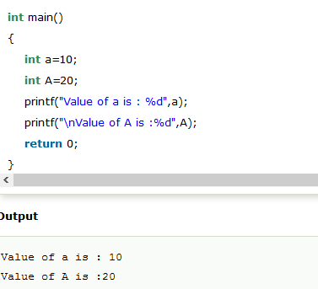
Let's understand through an example.

Slide 41
Operators in C
There are following types of operators to perform different types of operations in C language.
Arithmetic Operators
Relational Operators
Shift Operators
Logical Operators
Bitwise Operators
Ternary or Conditional Operators
Assignment Operator
Misc Operator

Slide 42
Operators in C
Category | Operator | Associativity
Postfix | () [] -> . ++ - - | Left to right
Unary | + - ! ~ ++ - - (type)* & sizeof | Right to left
Multiplicative | * / % | Left to right
Additive | + - | Left to right
Shift | << >> | Left to right
Relational | < <= > >= | Left to right
Equality | == != | Left to right
Bitwise AND | & | Left to right
Bitwise XOR | ^ | Left to right
Bitwise OR | | | Left to right
Logical AND | && | Left to right
Logical OR | || | Left to right
Conditional | ?: | Right to left
Assignment | = += -= *= /= %=>>= <<= &= ^= |= | Right to left
Comma | , | Left to right

Slide 43
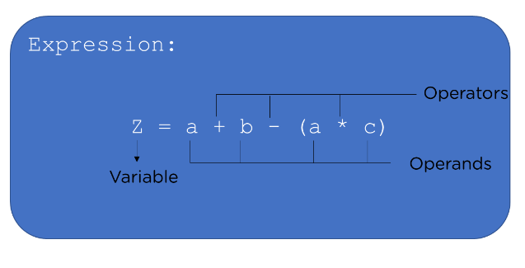
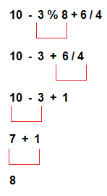
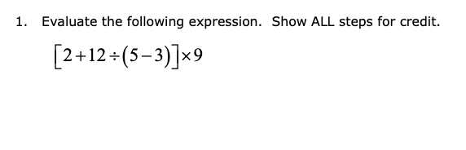
Expression Evaluation

Slide 44
Comments in C
Comments in C used to provide information about lines of code.
It is widely used for documenting code.
There are 2 types of comments in the C language.
Single Line Comments
//printing information
Multi-Line Comments
/*
code
to be commented
*/

Slide 45
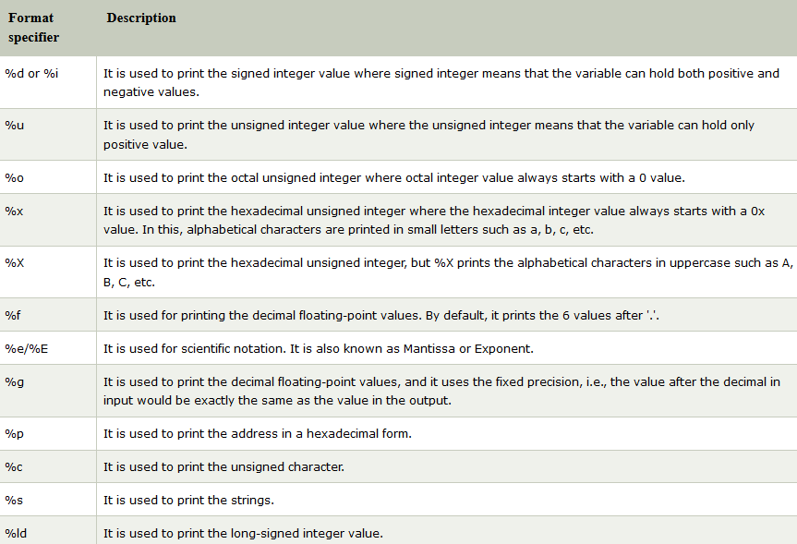
Format specifiers in printf()

Slide 46
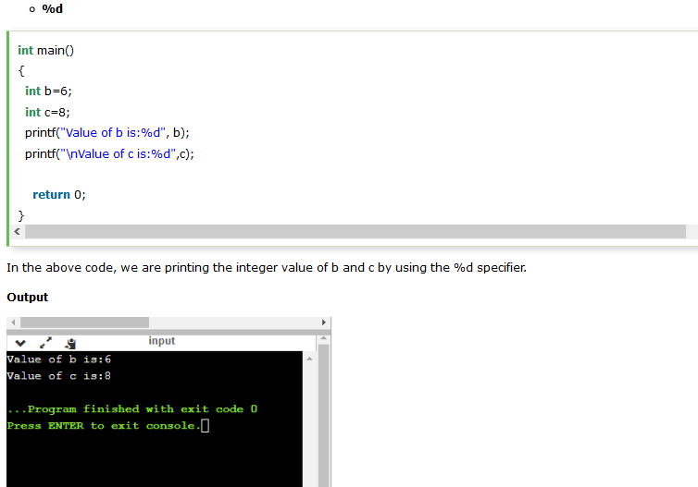

Slide 47
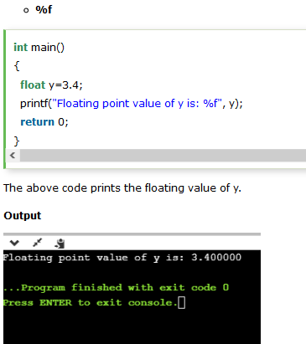
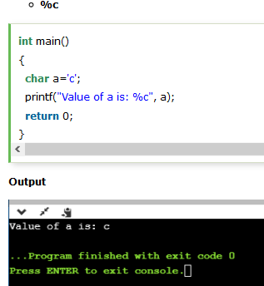

Slide 48
List of Escape Sequences in C
Escape Sequence | Meaning
\a | Alarm or Beep
\b | Backspace
\f | Form Feed
\n | New Line
\r | Carriage Return
\t | Tab (Horizontal)
\v | Vertical Tab
\\ | Backslash
\' | Single Quote
\" | Double Quote
\? | Question Mark
\nnn | octal number
\xhh | hexadecimal number
\0 | Null

Slide 49
Constants in C
A constant is a value or variable that can't be changed in the program, for example: 10, 20, 'a', 3.4, "c programming" etc.
List of Constants in C
Constant | Example
Decimal Constant | 10, 20, 450 etc.
Real or Floating-point Constant | 10.3, 20.2, 450.6 etc.
Octal Constant | 021, 033, 046 etc.
Hexadecimal Constant | 0x2a, 0x7b, 0xaa etc.
Character Constant | 'a', 'b', 'x' etc.
String Constant | "c", "c program", "c in javatpoint" etc.

Slide 50
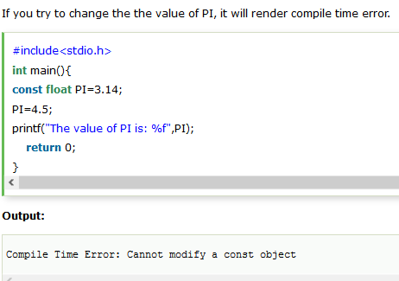

Slide 51
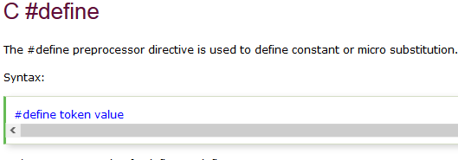
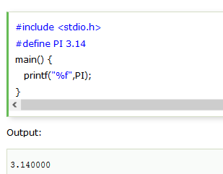

Slide 52
Types of literals in C
There are four types of literals that exist in C.
Integer literal
Float literal
Character literal
String literal

Slide 53
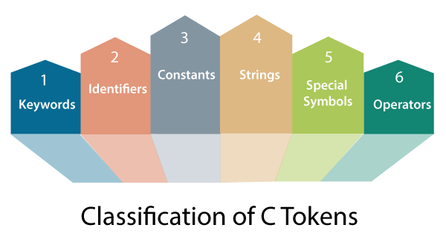
Tokens in C
We can define the token as the smallest individual element in C.
we can say that tokens in C is the building block or the basic component for creating a program in C language.

Slide 54
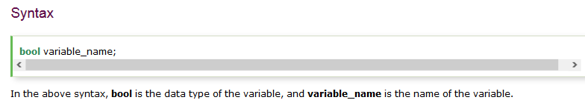
Boolean Datatype in C
In C, Boolean is a data type that contains two types of values, i.e., 0 and 1.
Basically, the bool type value represents two types of behavior, either true or false.
Here, '0' represents false value, while '1' represents true value.

Slide 55
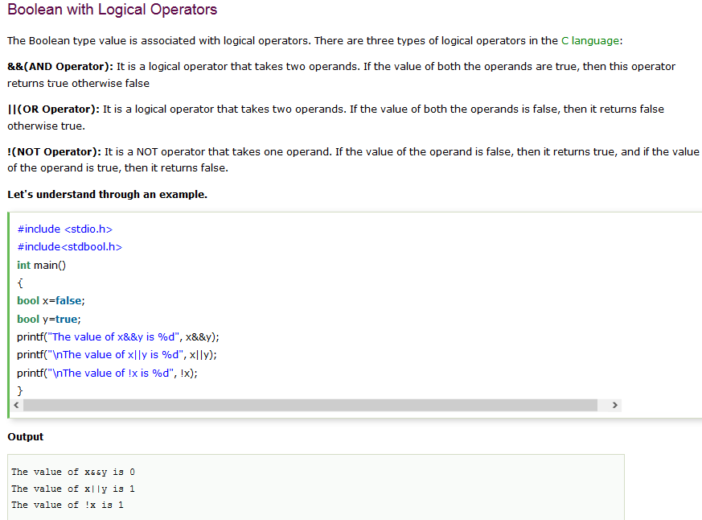

Slide 56
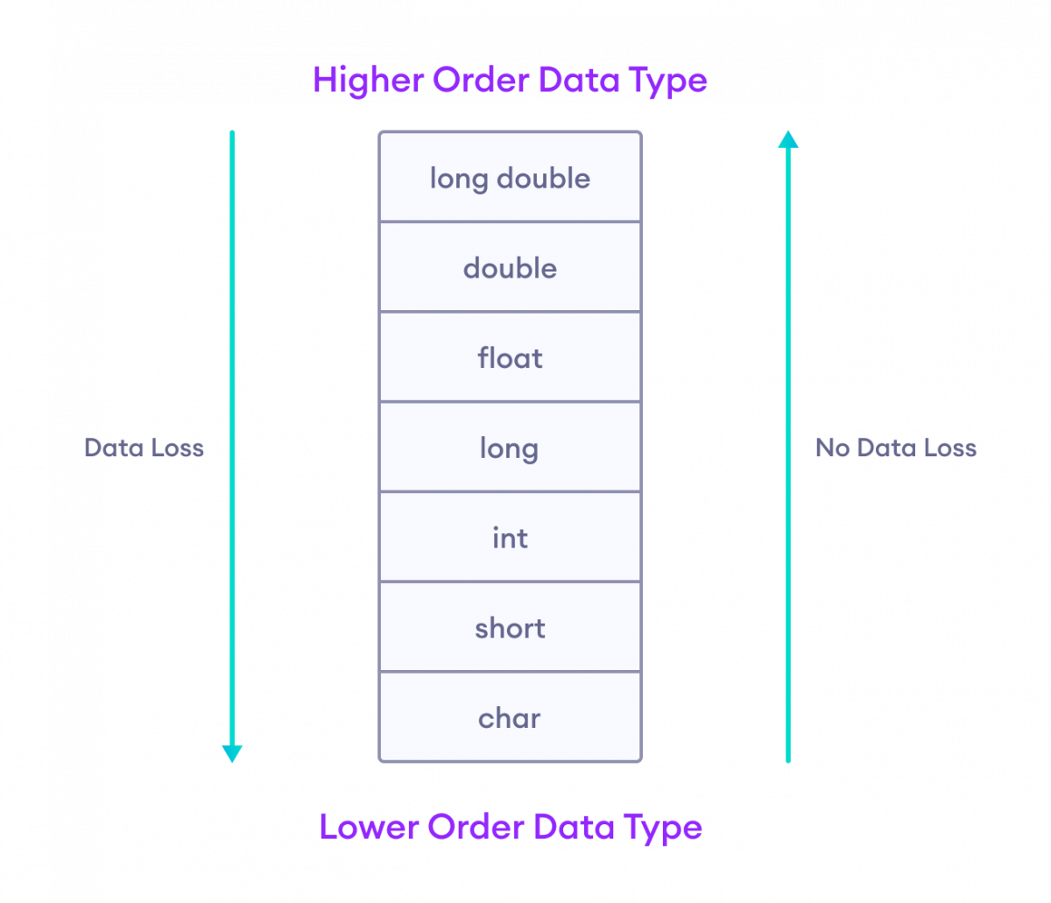
Type conversions in C

Slide 57
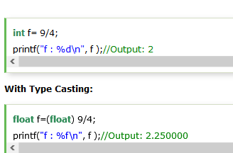
Type Casting in C
Typecasting allows us to convert one data type into other.
In C language, we use cast operator for typecasting which is denoted by (type).
Syntax:
(type)value;

Slide 58
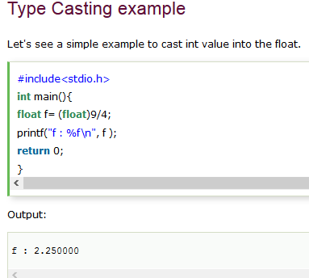

Slide 59
Conditional Statements in C
If statement
If-else statement
If else-if ladder
Nested if

Slide 60
If Statement
The if statement is used to check some given condition and to perform some operations depending upon the correctness of that condition
The syntax of the if statement:-
  if(expression)
  {
  //code to be executed
  }

Slide 61
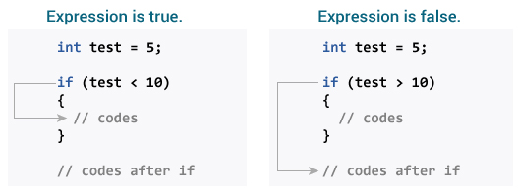
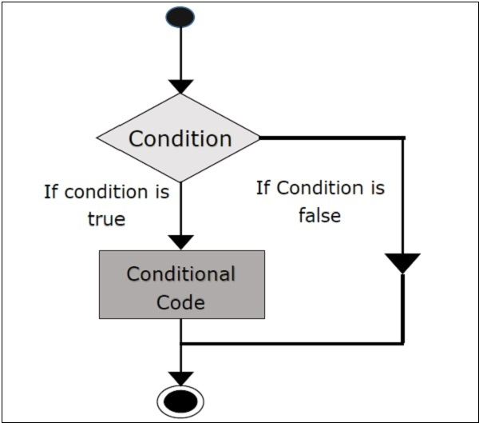

Slide 62
#include<stdio.h>
int main()
{
int number=0;
printf("Enter a number:");
scanf("%d",&number);
if(number%2==0)
{
printf("%d is even number",number);
}
return 0;
}
Output
Enter a number:4
4 is even number
enter a number:5

Slide 63
If-else Statement
The if-else statement is used to perform two operations for a single condition.
The if-else statement is an extension to the if statement using which, we can perform two different operations
The syntax of the if-else statement is given below.
if(expression)
  {
  //code to be executed if condition is true
  }
  Else
  {
  //code to be executed if condition is false
  }

Slide 64
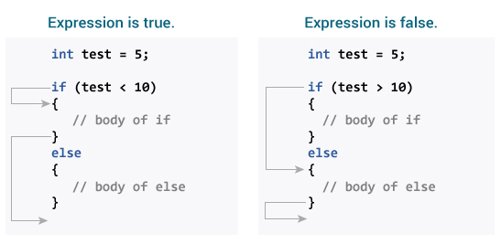
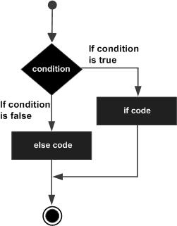

Slide 65
#include <stdio.h>
int main()
{
int age;
printf("Enter your age?");
scanf("%d",&age);
if(age>=18)
{
printf("You are eligible to vote...");
}
else
{
printf("Sorry ... you can't vote");
}
}
Output
Enter your age?18
You are eligible to vote...
Enter your age?13
Sorry ... you can't vote

Slide 66
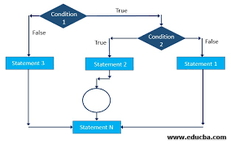
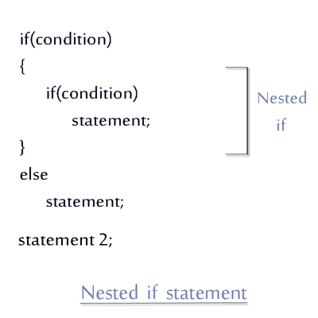
Nested if

Slide 67
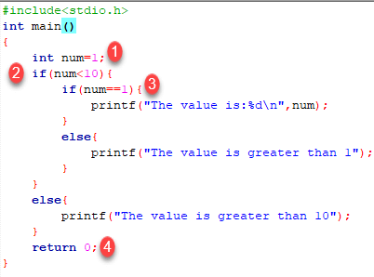
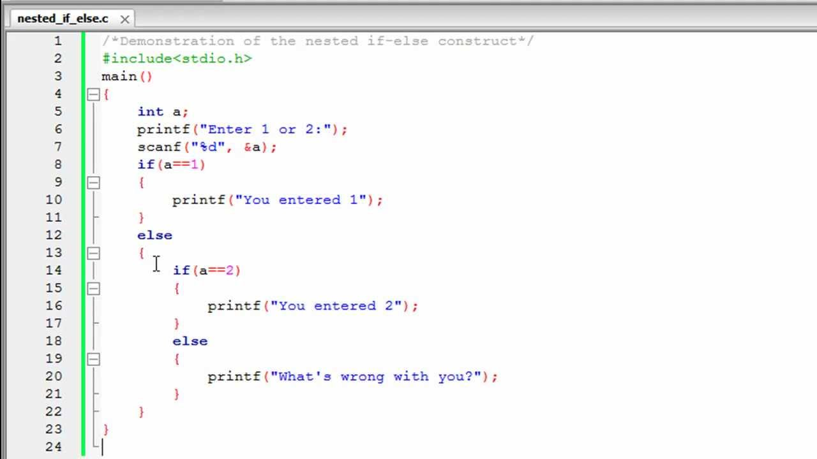

Slide 68
If else-if ladder Statement
The if-else-if ladder statement is an extension to the if-else statement.
It is used in the scenario where there are multiple cases to be performed for different conditions.
The syntax of the if-else-if statement is given below.
  if(condition1){
  //code to be executed if condition1 is true
  }
  else if(condition2){
  //code to be executed if condition2 is true
  }
  else if(condition3){
  //code to be executed if condition3 is true
  }
  ...
  else{
  //code to be executed if all the conditions are false
  }

Slide 69
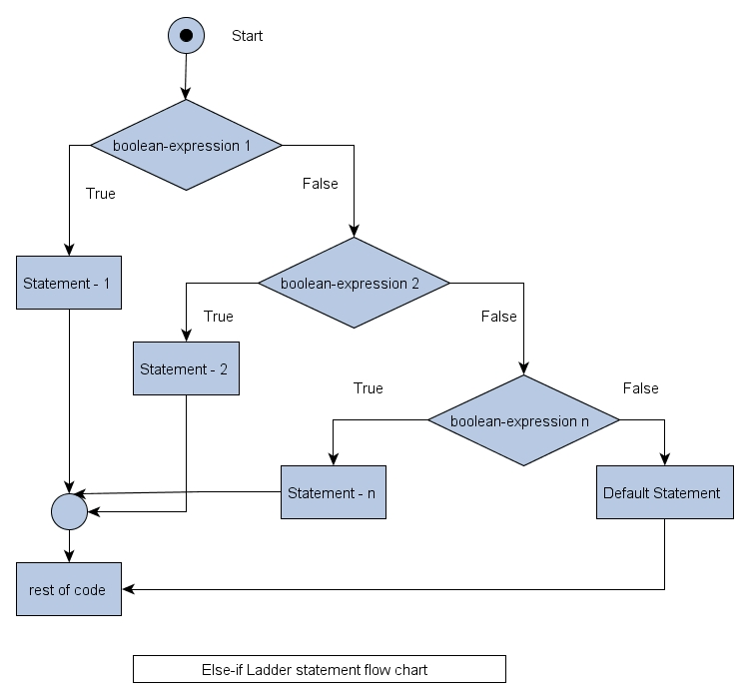
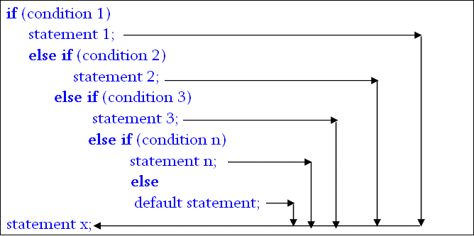

Slide 70
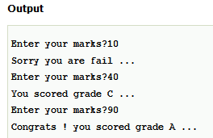
Program to calculate the grade of the student according to the specified marks.
#include <stdio.h>
int main()
{
int marks;
printf("Enter your marks?");
scanf("%d",&marks);
if(marks > 85 && marks <= 100)
{
printf("Congrats ! you scored grade A ...");
}
else if (marks > 60 && marks <= 85)
{
printf("You scored grade B + ...");
}
else if (marks > 40 && marks <= 60)
{
printf("You scored grade B ...");
}
else if (marks > 30 && marks <= 40)
{
printf("You scored grade C ...");
}
else
{
printf("Sorry you are fail ...");
}
}

Slide 71

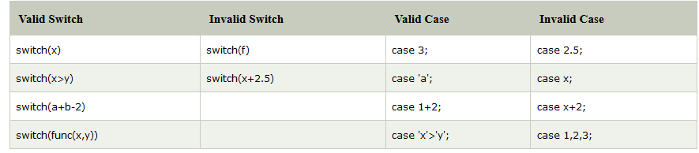
Switch Statement in C
The switch statement in C is an alternate to if-else-if ladder statement which allows us to execute multiple operations for the different possible values of a single variable called switch variable.

Slide 72
switch statement
syntax :-
switch(expression)
  {
  case value1:
  //code to be executed;
  break; //optional
  case value2:
  //code to be executed;
  break; //optional
  ......
  default:
  code to be executed if all cases are not matched;
  }

Slide 73
Rules for switch statement in C
The switch expression must be of an integer or character type.
2) The case value must be an integer or character constant.
3) The case value can be used only inside the switch statement.
4) The break statement in switch case is not must. It is optional.
If there is no break statement found in the case, all the cases will be executed present after the matched case.
It is known as fall through the state of C switch statement.

Slide 74
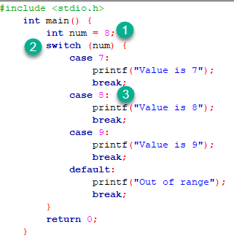

Slide 75
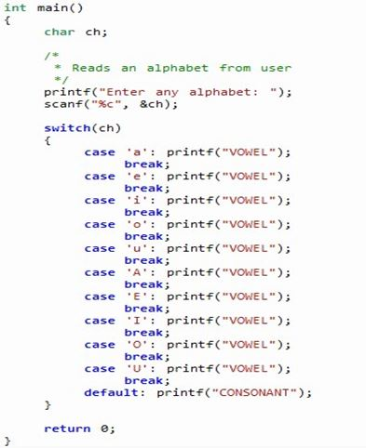

Slide 76
Iterative Statements
There are three types of loops in C language that is given below:
do while
while
for

Slide 77
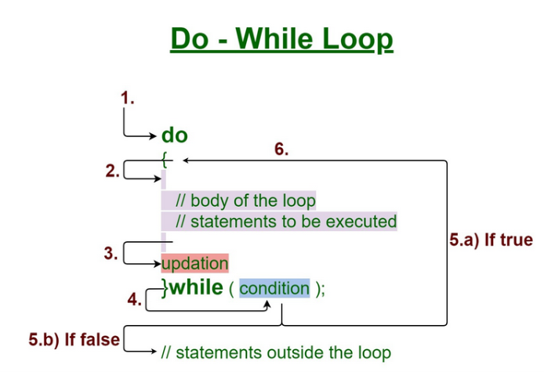
Do while loop in c with example
    Syntax:-
    do
    {
    //Body of the loop
    Update Expression;
    }
    while(condition);

Slide 78
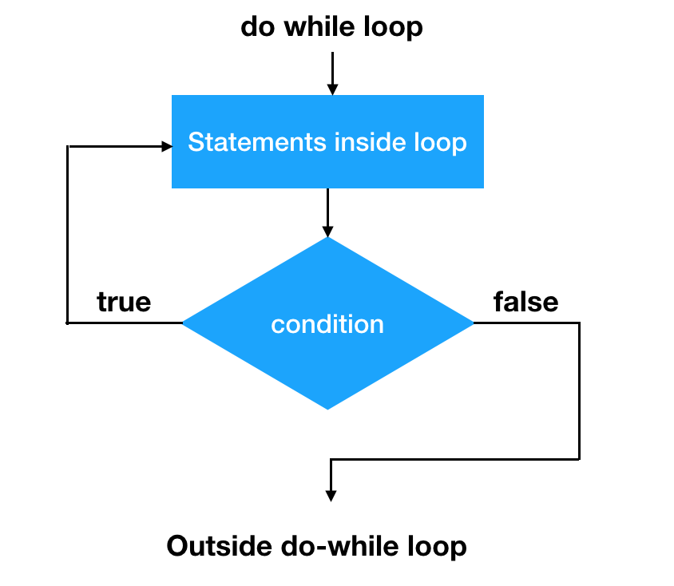
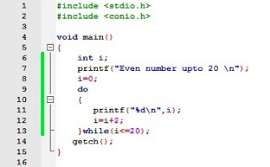
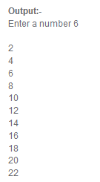

Slide 79



While loop
While loop is also known as a pre-tested loop
Mostly used in the case where the number of iterations is not known in advance

Slide 80



Slide 81

for loop in C
The for loop in C language is used to iterate the statements. It is frequently used to traverse the data structures like the array and linked list.
Syntax of for loop in C:-
for(Expression 1; Expression 2; Expression 3){
//code to be executed
}

Slide 82

while loop inside another while loop is known as nested while loop.
In nested while loop one or more statements can be included in the body of the loop.
Nested while loop in C
Nested While loop
/*The syntax for a nested while loop statement in C.
while(condition) {
while(condition) {
statement(s);
}
statement(s);
}*/

Slide 83



Slide 84


Slide 85



Slide 86

Break Statement in C
The break is a keyword in C which is used to bring the program control out of the loop.
The break statement is used inside loops or switch statement.
It breaks the inner loop first and then proceeds to outer loops
The break statement breaks the loop one by one

Slide 87

Break example
#include<stdio.h>
#include<stdlib.h>
void main ()
{
int i;
for(i = 0; i<10; i++)
{
printf("%d ",i);
if(i == 5)
break;
}
printf("came outside of loop i = %d",i);
}

Slide 88

The continue statement in C language is used to bring the program control to the beginning of the loop.
The continue statement skips some lines of code inside the loop and continues with the next iteration.
continue statement in C
#include<stdio.h>
void main ()
{
int i = 0;
while(i!=10)
{
printf("%d", i);
continue;
i++;
}
}

Slide 89

The goto statement is known as jump statement in C
goto statement in C
Syntax:-
  label:
  //some part of the code;
  goto label;
#include <stdio.h>
int main()
{
int num,i=1;
printf("Enter the no whose table you want to print?");
scanf("%d",&num);
table:
printf("%d x %d = %d\n",num,i,num*i);
i++;
if(i<=10)
goto table;
}

Slide 90


